Slide 1
Lecture 4: Text, recurrent neural networks,
and transformers
Practical deep learning

Slide 2
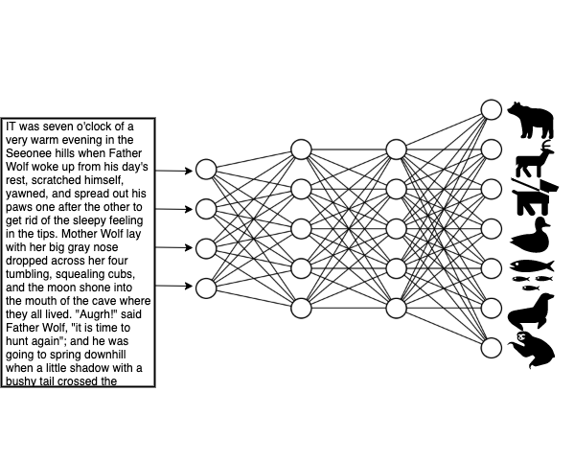

Slide 3
Representations for text

Slide 4
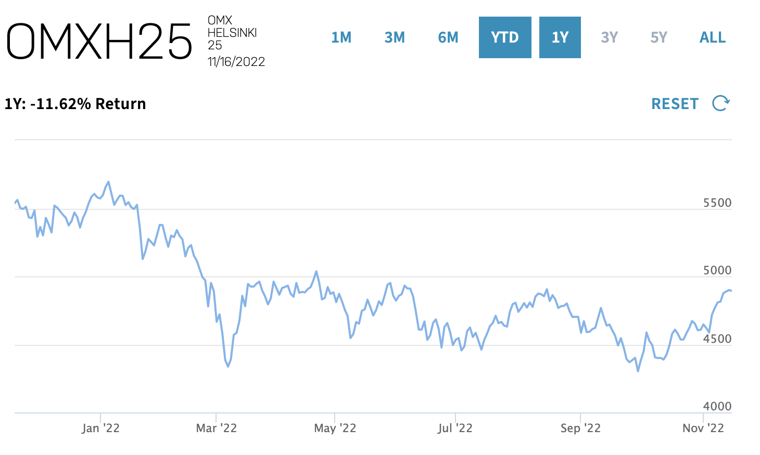
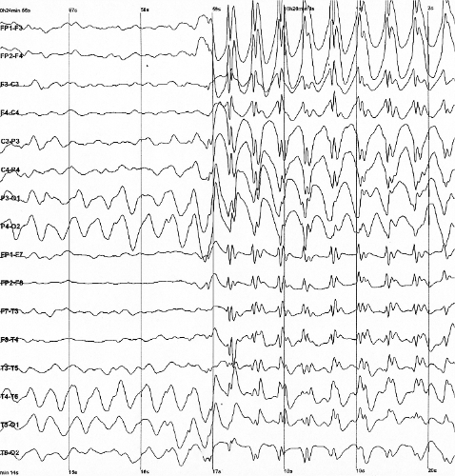
Sequential data
By Der Lange 11/6/2005, http://commons.wikimedia.org/w/index.php?title=File:Spike-waves.png

Slide 5
Text data
sequence of words (or characters)
from a vocabulary
main representations:
one-hot or sparse encoding
word embeddings
preprocessing
tokenization
vectorization
sparse encoding
raw text
cleaned text
tokens
word embedding
The cat is in the moon.
[“the”, “cat”, “is”, “in”, “the”, “moon”]
[ 3, 78, 16, 9, 3, 458 ]

Slide 6
One-hot encoding and bag-of-words
dimensionality equals the number of distinct tokens in dictionary
1000’s or 10000’s
tokens are independent of each other
bag-of-words loses the ordering of tokens
lots of important applications: IR etc.
n-grams
dictionary
{“a”: 1, “aardvark”: 2, “aardwolf”: 3, …}
one-hot encoding
bag of words
cleaned text
tokens
The cat is in the moon.
[“the”, “cat”, “is”, “in”, “the”, “moon”]

Slide 7
Word embeddings*
dense vector representations
dimensionality typically much lower than size of vocabulary
can be learned based on context of words
“a word is characterized by the company it keeps” (Firth)
pre-trained embeddings (word2vec, GLoVe, fastText, …) exist
or (/and) from training data as part of the neural network
semantics
similar words have similar vectors
directions in the vector space map to semantic relationships
*) a numerical representation (usually a vector) of a non-numeric entity (e.g. word, sentence, document, image)

Slide 8
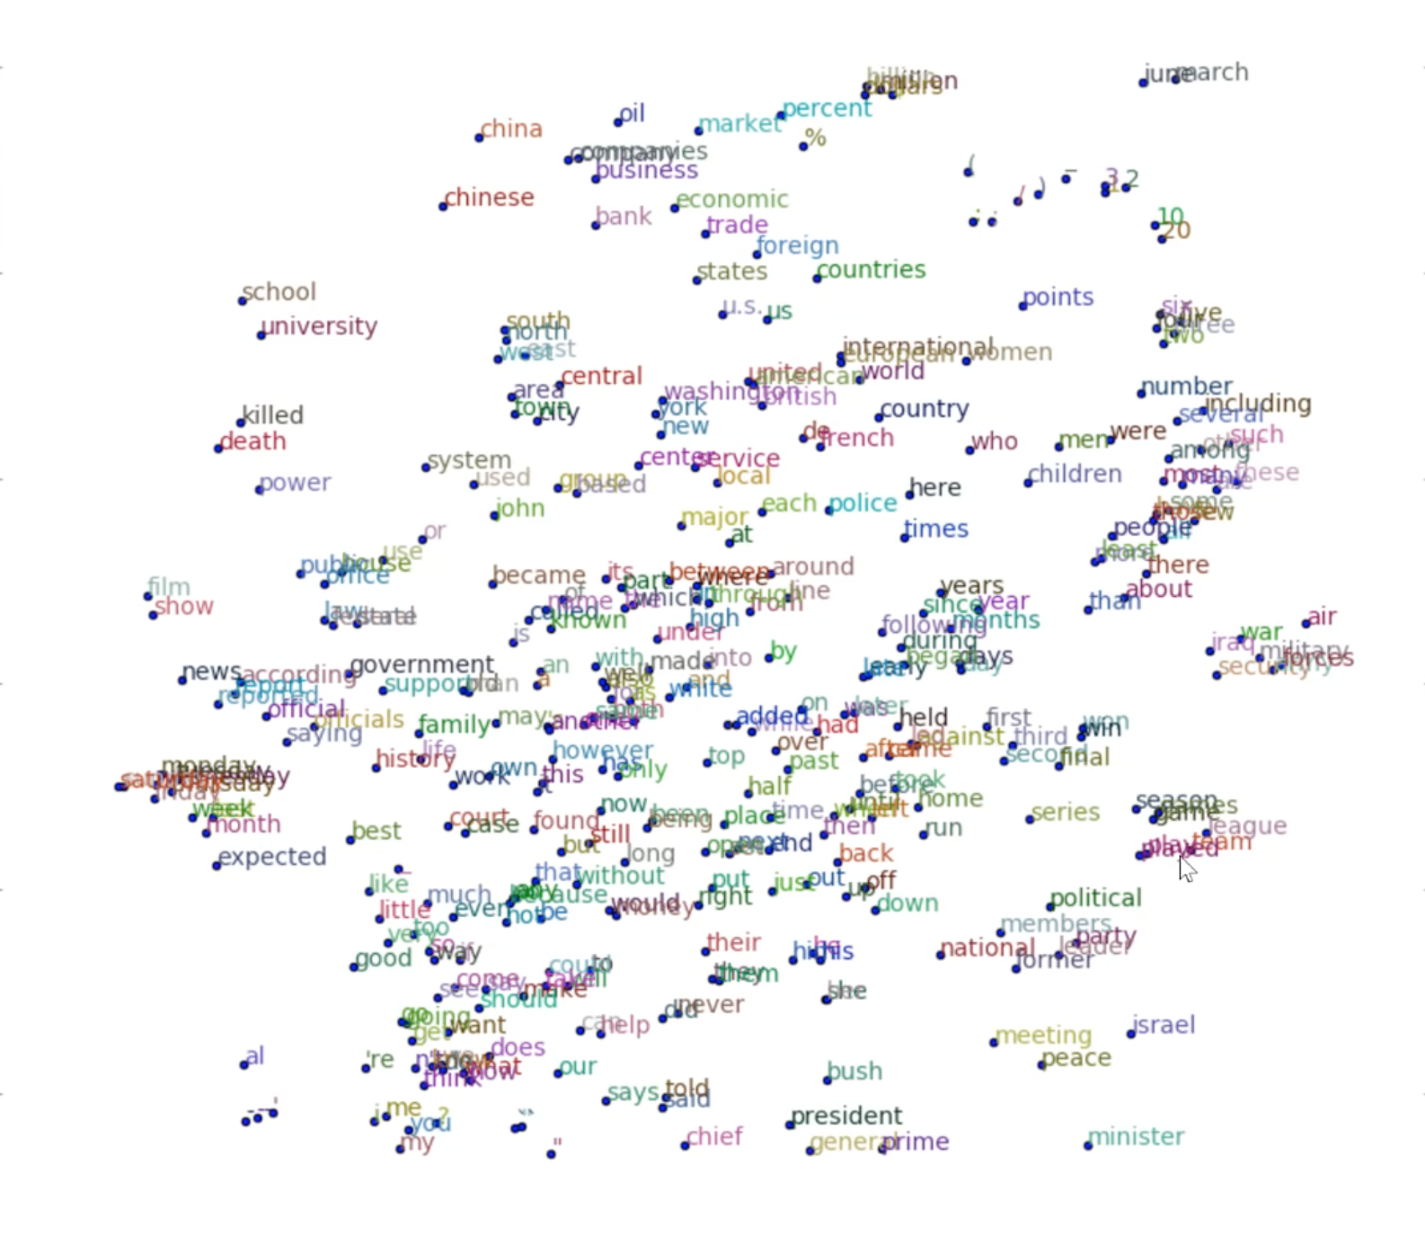
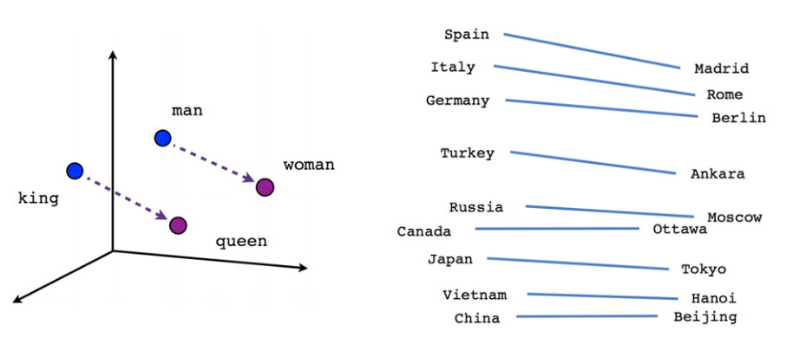
Word embeddings
Images from: https://www.tensorflow.org/tutorials/word2vec
Image from: http://wiki.fast.ai/index.php/Lesson_5_Notes

Slide 9
Standalone word embedding algorithms
self-supervised learning, no annotation needed
popular context-free algorithms:
word2vec
GLoVe
fastText
contextual algorithms:
ELMo
BERT
to learn a task-based embedding or to use a pre-trained one?
pre-trained embeddings encode general semantic relationships
need to handle OOV (out-of-vocabulary) words
task-based may sometimes be better if enough data

Slide 10
Word sequence embedding
usually a fixed-size matrix or sequence
in PyTorch: torch.nn.Embedding(num_embeddings, embedding_dim)
learned embedding
cleaned text
tokens
padding / truncate
sequence embedding
The cat is in the moon.
[“the”, “cat”, “is”, “in”, “the”, “moon”]
[“the”, “cat”, “is”, “in”, “the”, “moon”, ∅, ∅, ∅, ∅]
10 × N matrix or sequence of length 10
[ 3, 78, 16, 9, 3, 458 ]
[ 3, 78, 16, 9, 3, 458, 0, 0, 0, 0 ]

Slide 11
Deep learning for sequences

Slide 12
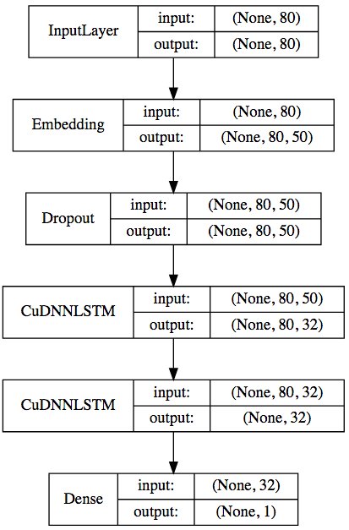
Deep learning for sequences
first layers are usually vectorization and embedding (if needed)
then there are three main approaches (that can also be combined):
(1. convolutional layers)
2. recurrent layers
3. attention + dense layers
last layers are often dense

Slide 14
(1) CNNs for sequences
Convolutional layer
a fixed-length embedded sequence is a matrix
can be considered as an image ⇒ CNNs
1D convolution
as we want to process the full embedding each time
simple and cheap approach for simple tasks
in tf.keras: layers.Conv1D(filters, kernel_size, padding, activation) layers.MaxPooling1D(pool_size) layers.GlobalMaxPooling1D()

Slide 15
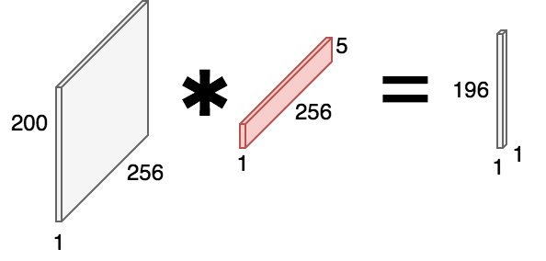
1D convolution
tokens
embedding

Slide 16

(2) Recurrent neural networks
MLPs and CNNs expect fixed-sized parallel input, not sequences
RNNs have memory and recurrent connections, i.e. loops
last output contains a representation of the whole sequence
learning by backpropagation through time
can be tricky: vanishing or exploding gradients!
By François Deloche [CC BY-SA 4.0], from Wikimedia Commons

Slide 17

Recurrent neural networks
Image from: http://karpathy.github.io/2015/05/21/rnn-effectiveness/

Slide 18
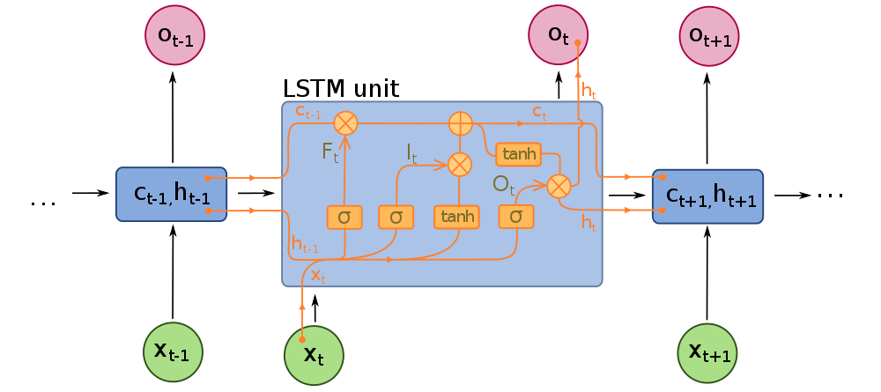
Long-short term memory (LSTM) network
RNNs can be harder to train than feedforward networks
LSTM: specialized model to solve the vanishing gradient problem
additional “conveyor belt” dataflow to carry information across timesteps
“forget”, “input”, and “output” gates
By François Deloche [CC BY-SA 4.0], from Wikimedia Commons

Slide 19
LSTM layer
basic RNNs do not usually work in practice ⇒ use LSTM or its variants (e.g. GRU)
can also be used bidirectionally
in PyTorch: torch.nn.LSTM(input_size, hidden_size, num_layers, bidirectional)

Slide 20
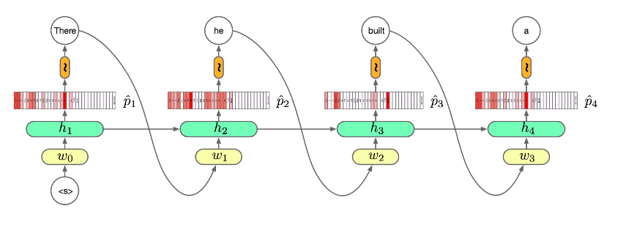
Language models and text generation
RNNs can be trained to predict the next word and then used to generate novel text (or music, etc.)
Image from: https://github.com/oxford-cs-deepnlp-2017/lectures/blob/master/Lecture%204%20-%20Language%20Modelling%20and%20RNNs%20Part%202.pdf

Slide 21
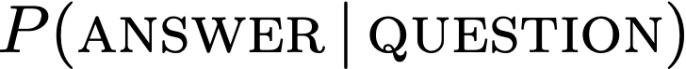
What is a language model?
Probability assigned to a piece of text

Slide 22
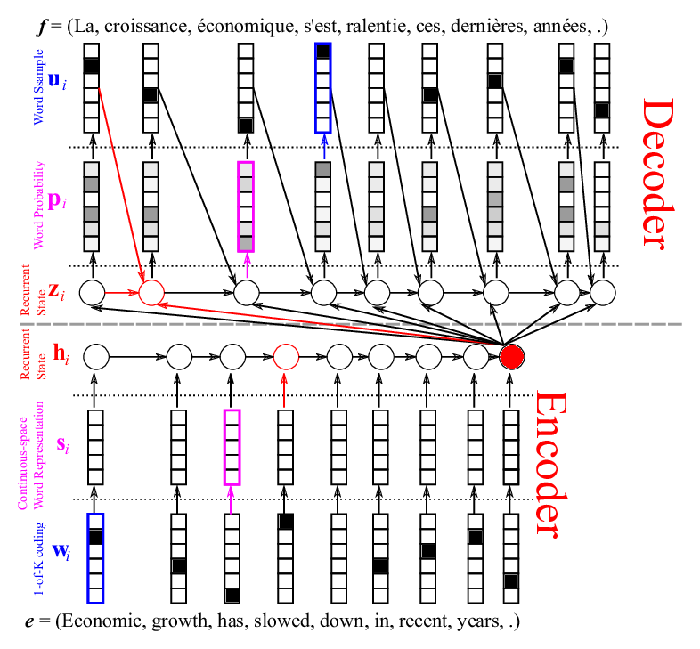
Encoder–decoder (seq2seq) networks
Image from: https://devblogs.nvidia.com/introduction-neural-machine-translation-gpus-part-2/

Slide 23
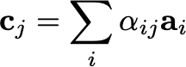
(3) Attention
dense
CNN
CNN
Problem: the final encoder output vector is a bottleneck
Solution: attention
allows the model to focus on the relevant part of the input sequence
all encoder output vectors are passed to the decoder and are soft-weighted using a learned alignment
attention
attention

Slide 24
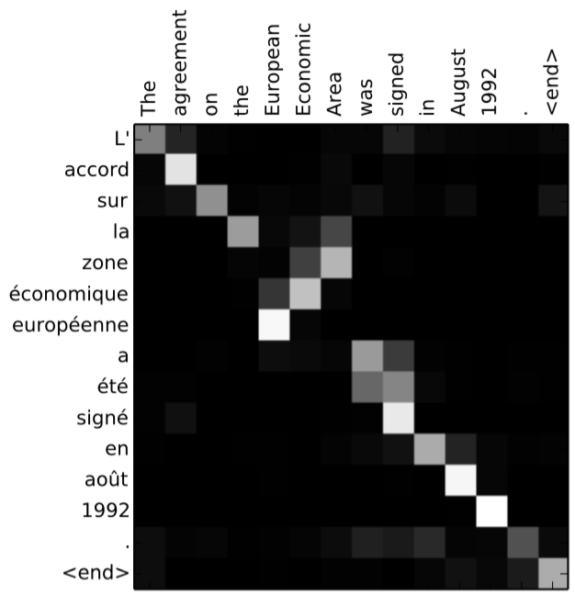
Attention
Image from: https://arxiv.org/abs/1409.0473

Slide 25
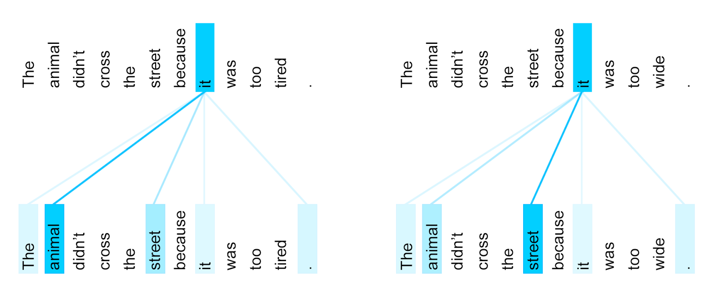
Attention is all you need [link] – Transformer
No CNNs or RNNs needed! => fast training and easy scaling-up
Self-attention: allows the model to associate each individual word in the input to other words in the input
self-attention
Image from: https://ai.googleblog.com/2017/08/transformer-novel-neural-network.html

Slide 26

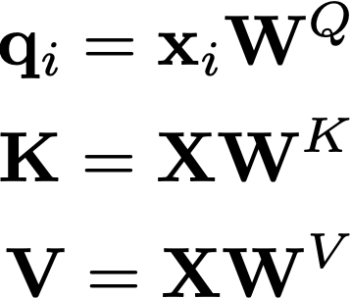
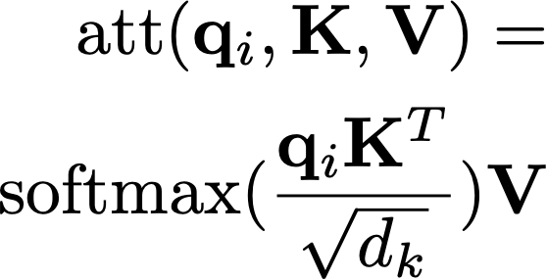
Queries, keys, values
“take the query, find the most similar keys, get the values that correspond to these keys”
Image from: https://jalammar.github.io/illustrated-transformer/

Slide 27
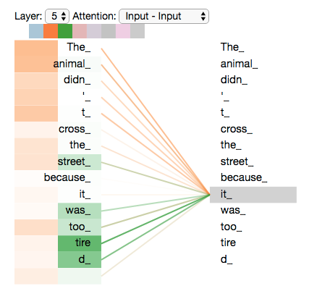
Multi-headed attention
To retrieve more “meaning”, do attention multiple times with different Q, K, V matrices: e.g., one for neighbor words, one for grammar, one for vocabulary, one for tense...
Image from: https://jalammar.github.io/illustrated-transformer/

Slide 28
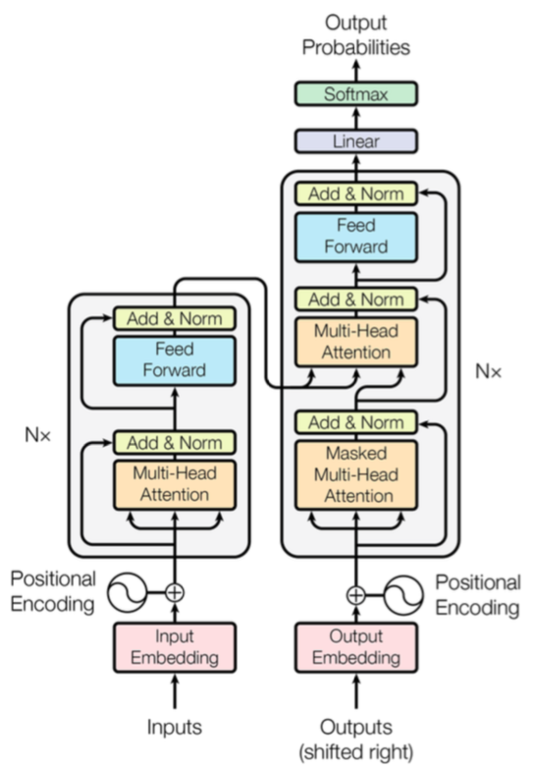

Transformer architecture
Image from: https://jalammar.github.io/illustrated-gpt2/
Image from: https://arxiv.org/abs/1706.03762

Slide 29
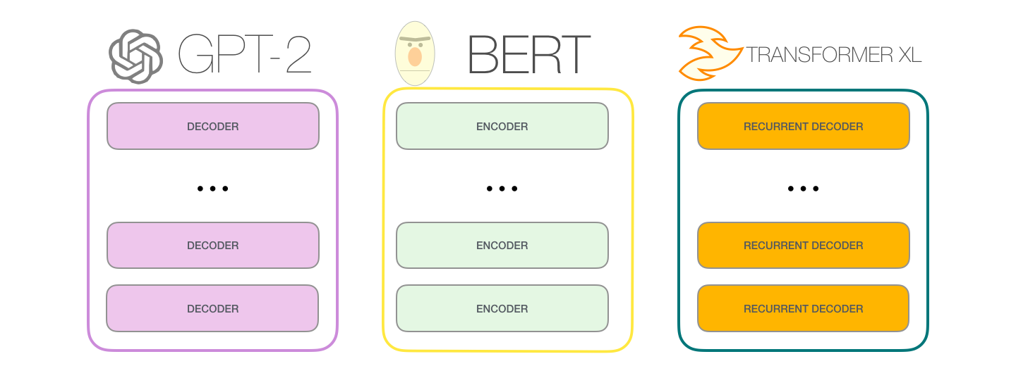
Models based on Transformer
N
ALL WORK AND NO [???] MAKES JACK A [???] BOY
ALL WORK AND NO PLAY MAKES JACK A DULL [???]
Images from: https://jalammar.github.io/illustrated-gpt2/
Encoder models / BERT-like: masked LM: predict the masked words
Decoder models / GPT-like: left-to-right LM: predict the next word
Full transformer, i.e. encoder + decoder models

Slide 30
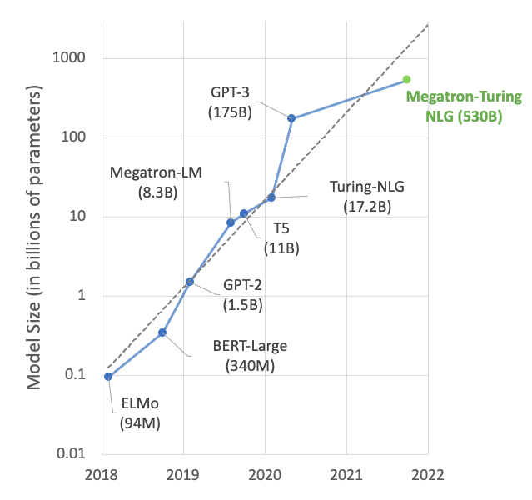
Scale
Wu Dao 2.0 (1.75T)
Large language models (LLMs) have been growing at an exponential rate.
For example, GPT-3:
175 Billion parameters (100 x GPT-2; 700 GB as fp32)
300 Billion tokens of training data (30 x GPT-2; English Wikipedia: 3.6 B)
355 GPU years of compute to train (V100) (13 months of entire Puhti-AI, 243 M BU, 5.1 M€)
LaMDA (137B)
Galactica (120B)
T0 (11B)
Image from: https://developer.nvidia.com/blog/using-deepspeed-and-megatron-to-train-megatron-turing-nlg-530b-the-worlds-largest-and-most-powerful-generative-language-model/

Slide 31
Scale
Wu Dao 2.0 (1.75T)
Large language models (LLMs) have been growing at an exponential rate.
Llama 3.1:
405 Billion parameters
15 Trillion tokens of training data
Approximately 100M GPU hours to train on LUMI hardware (~1 year of entire LUMI-G)
LaMDA (137B)
Galactica (120B)
T0 (11B)
Image from: https://developer.nvidia.com/blog/using-deepspeed-and-megatron-to-train-megatron-turing-nlg-530b-the-worlds-largest-and-most-powerful-generative-language-model/

Slide 32
Applications of Transformer-based models
Trained with massive text corpora (self-supervised learning)
many versions and variants available as pre-trained models
BERT-like: generic NLP tasks (classification, QA), create embeddings
GPT-like: GenAI, prompt engineering, RAG
Full transformer: machine translation
Download and use a pre-trained model as is
Fine-tune with own data
Train from scratch with (lots of) own data

Slide 33
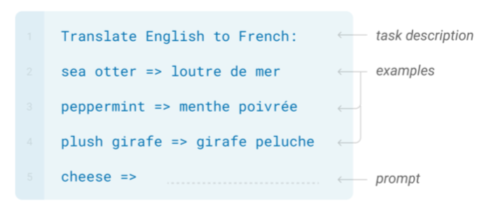
Prompting
my output
GPT-N
my test data
GPT-like models can be adapted to a specific task by providing a task description (and a few examples) as natural language
No further training needed!
Image from: https://arxiv.org/abs/2005.14165
my task description + few examples + my input

Slide 34
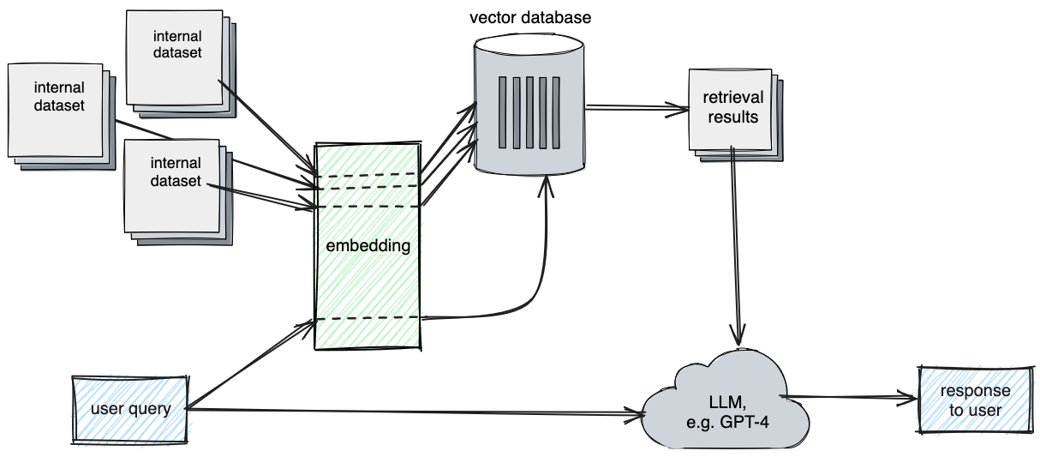
Retrieval augmented generation (RAG)

Slide 35
Fine-tuning
my output
my ML application
my test data
Pre-trained general model can be fine-tuned to a specific task
Some amount of further training with task-specific data is needed
my training data
my input

Slide 36

Vision Transformer
Animation from: https://ai.googleblog.com/2020/12/transformers-for-image-recognition-at.html

